Slide 1
Unit 2- Nearest Neighbor-Based Models

Slide 2
Introduction to Proximity Measures
Proximity measures form the core foundation of instance-based learning models like Nearest Neighbors. In machine learning, proximity defines how close or similar two data objects are in a multidimensional feature space. When a model receives a new, unseen instance, it does not refer to a pre-computed mathematical equation; instead, it compares the new instance directly to stored training examples using proximity measures.

Slide 3
Instead of learning a complicated mathematical formula to make predictions, an instance-based model acts like a search engine for past experiences.
The Feature Space (The Comparison Board): Imagine plotting items on a grid based on their features (like height and weight). The "space" is just the map where all your data points live.
Proximity (Distance): How close two points sit to each other on that map. If two points are close together, the model assumes they are almost identical and should have the same answer.
Making a Prediction: When a new, unknown object appears, the model looks at its map, finds the closest known objects (its "nearest neighbors"), and copies their answers.

Slide 4
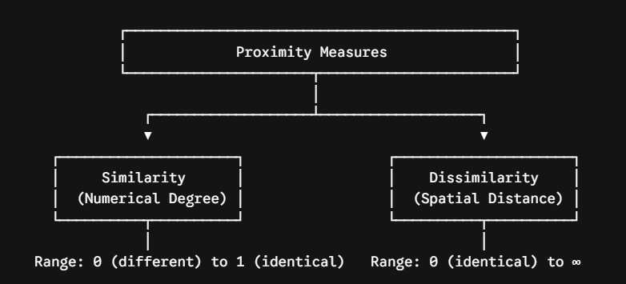
Proximity is divided into two primary concepts: Similarity and Dissimilarity.

Slide 5
Similarity $s(p, q)$: A numerical degree of how alike two data objects $p$ and $q$ are. Similarity is non-negative and typically falls bounded between $0$ (completely dissimilar) and $1$ (completely identical). When $p = q$, $s(p, q) = 1$.
Similarity is a score for "how alike" two things are:
Score = 1 (100%): The items are exact clones (perfect match).
Score = 0 (0%): The items share nothing in common at all.
Between 0 and 1: Tells you how much overlap exists (e.g., 0.85 means 85% similar).
Dissimilarity $d(p, q)$: A numerical degree of how different two data objects are. Dissimilarity increases as the items become less alike. The minimum dissimilarity is often $0$ when objects are identical, and its upper bound can go up to infinity depending on the function used.
Dissimilarity is just a score for "how different" two things are:
Score = 0: The items are identical twins (zero difference).
Score gets bigger: The items are getting more and more different.
Score keeps growing: There is no maximum limit (infinity)—the more completely opposite two things are, the higher the distance number can go.

Slide 6
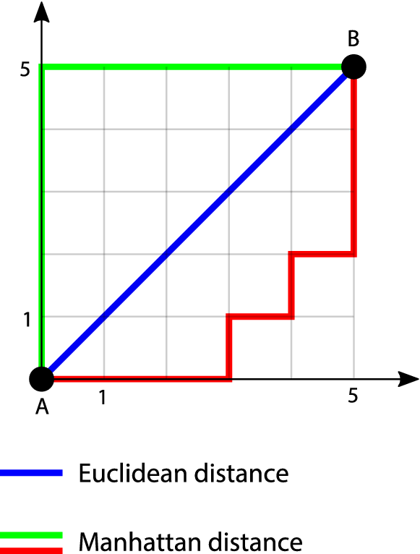
Distance Measures
Distance measures are mathematical formulas used to quantify how close or far apart two data points are in a feature space. They serve as the core decision metric for machine learning algorithms like K-Nearest Neighbors (KNN), K-Means Clustering, and Support Vector Machines (SVM).

Slide 7
Key attributes of distance measures:
➢Positive reflexivity: d(x,x) = 0
➢Symmetry: d(x,y) = d(y,x)
➢Triangular inequality: d(x,y) d(x,z) + d(z,y)
Non-negativity ($d(x, y) \ge 0$):Spatial distance can never be negative.Always mention that distance is bounded below by 0.
Identity of Indiscernibles ($d(x, y) = 0 \iff x = y$):Two points have a distance of 0 if and only if they are the exact same data point. If two data samples differ in even one attribute, the distance must be $> 0$.
Symmetry ($d(x, y) = d(y, x)$):The distance from point A to point B is identical to the distance from B to A.
Triangle Inequality ($d(x, z) \le d(x, y) + d(y, z)$):Taking a direct path from A to C is always shorter than (or equal to) making a pitstop at B.

Slide 8
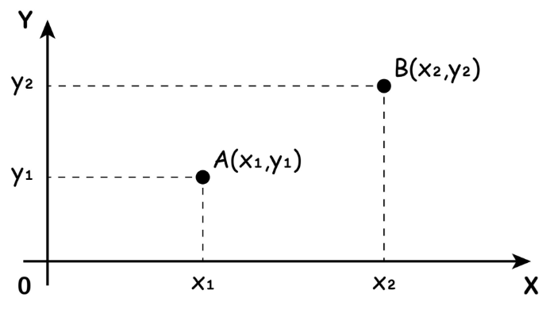
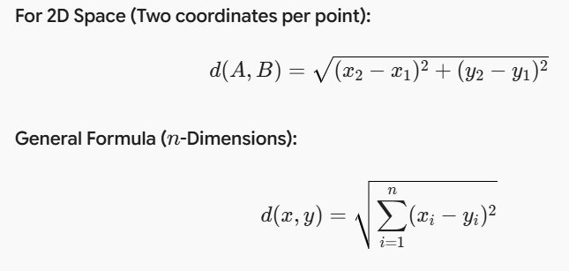
Euclidean Distance is the straight-line distance between two points in a space, calculated directly using the Pythagorean theorem. It measures the shortest physical distance between two points by taking the square root of the sum of squared differences between their corresponding coordinates.
Straight-line distance between two points on a plane.

Slide 9
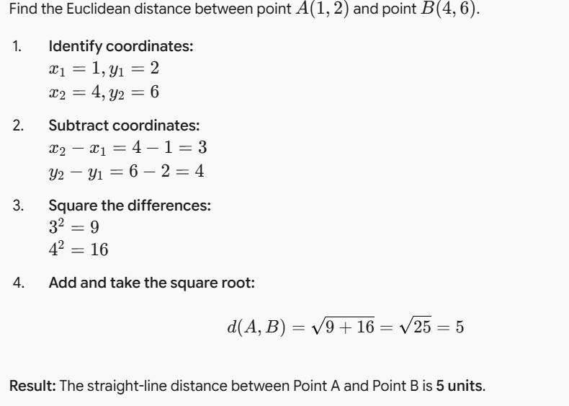

Slide 10
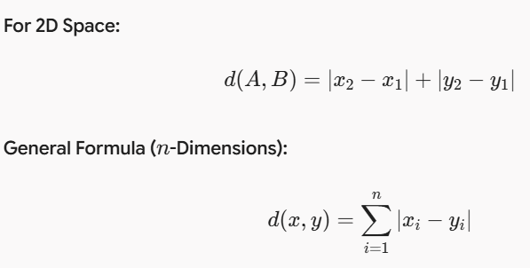
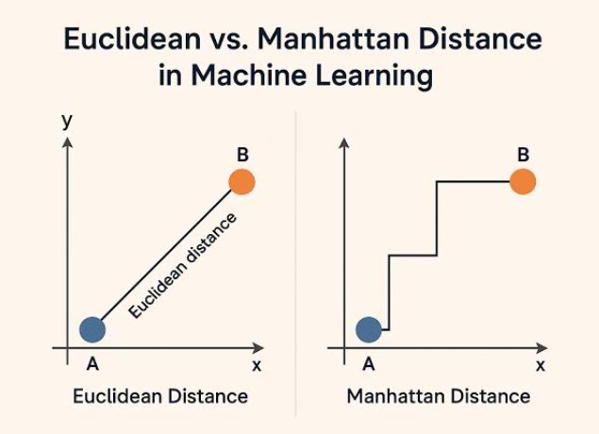
Manhattan Distance:Manhattan distance (also called City Block or Taxicab distance) measures the distance between two points by moving only along grid lines at right angles—mimicking how a taxi drives through street blocks in a city grid.
Manhattan grid path vs Euclidean line

Slide 11
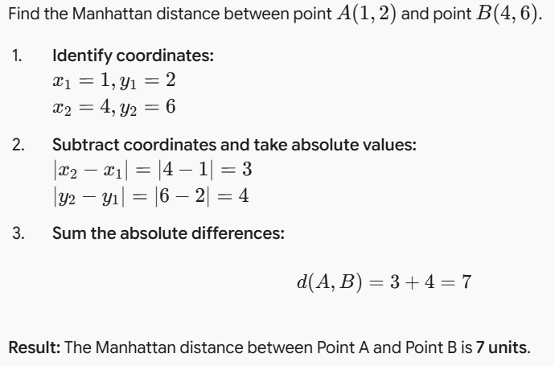

Slide 12
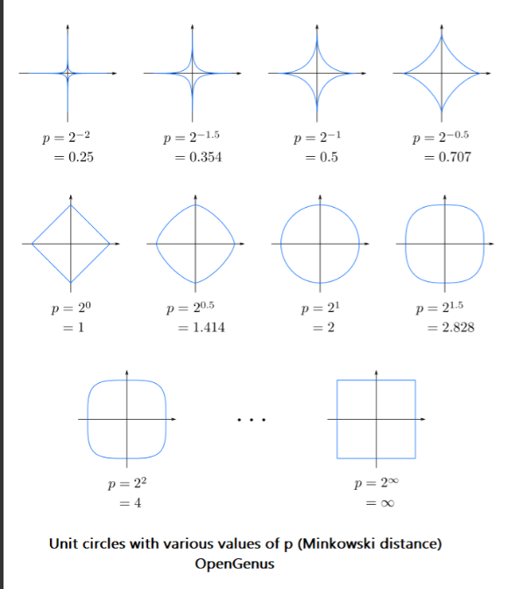
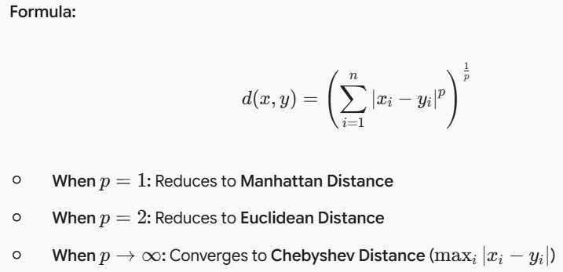
Minkowski distance :Minkowski distance is a generalized mathematical formula that unifies both Manhattan and Euclidean distances into a single equation using an adjustable order parameter $p$.

Slide 13
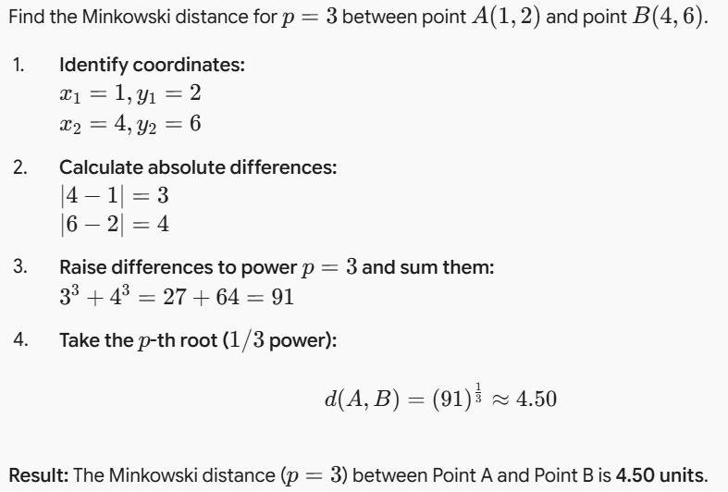

Slide 14
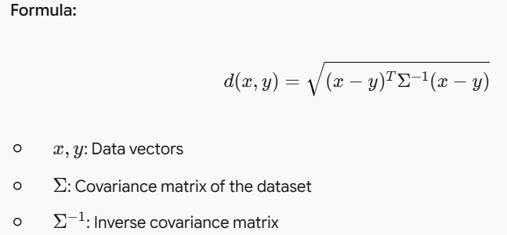
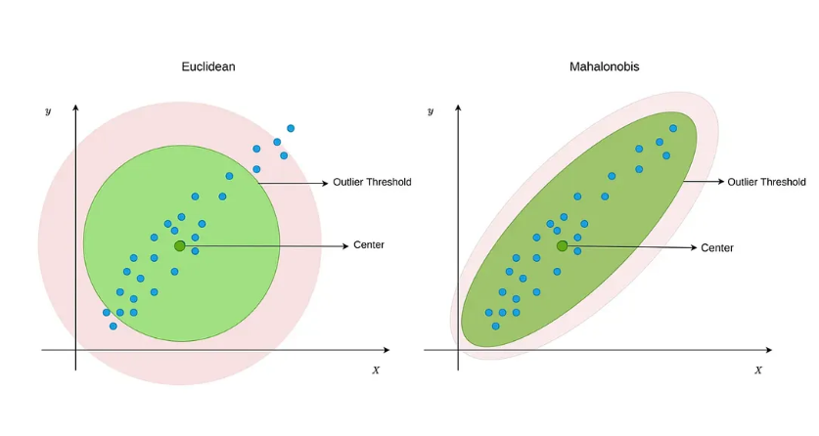
Mahalanobis Distance: Mahalanobis distance measures the distance between a point and a dataset distribution by accounting for how features vary (variance) and depend on each other (covariance).

Slide 15
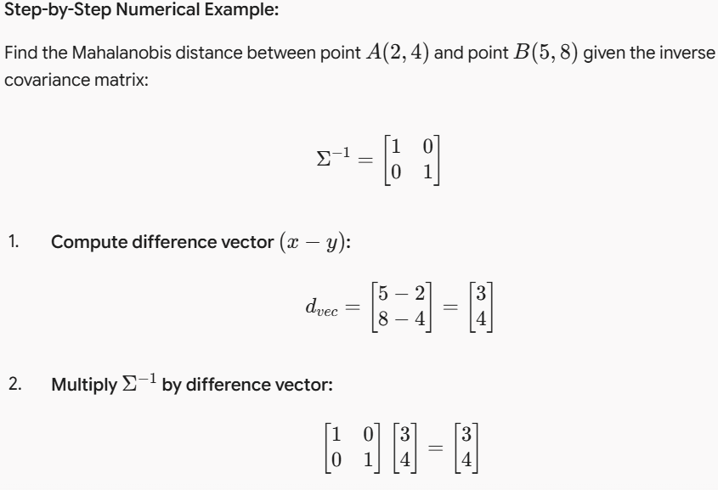

Slide 16
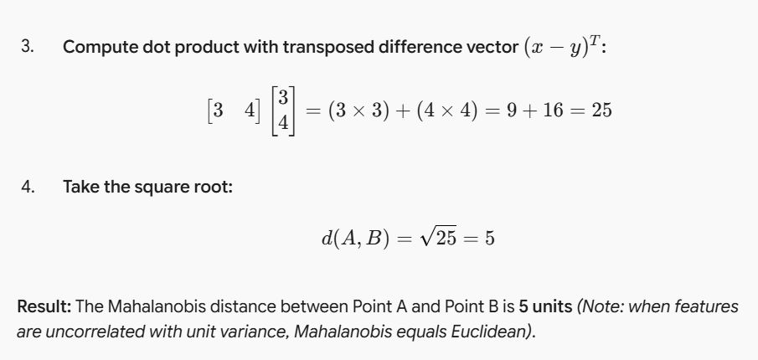

Slide 17
Non-Metric Similarity Functions
A non-metric similarity function measures the relationship or closeness between two data objects without adhering to all mathematical axioms of a formal distance metric.
In practice, data often violates metric rules—such as when direction matters more than distance, when comparisons are asymmetric, or when comparing complex structures like graphs, text sequences, or probability distributions.

Slide 18
Standard metric spaces enforce four specific axioms: non-negativity, identity of indiscernibles, symmetry, and the triangle inequality ($d(x, z) \le d(x, y) + d(y, z)$).
Non-metric functions deliberately relax one or more of these properties:
Symmetry Violation: Comparing object $A$ to $B$ is not always identical to comparing
$B$ to $A$ (e.g., probability divergence, hypernym relationships).
Triangle Inequality Violation: Direct similarity between $A$ and $C$ can be zero even if $A$ is similar
to $B$, and $B$ is similar to $C$ (e.g., polysemous words: "apple" $\approx$ "fruit", "fruit" $\approx$
"juice", but "apple" $\neq$ "juice" in specific embedding spaces).
Scale and Magnitude Invariance: Focuses purely on pattern or orientation rather than spatial position.

Slide 19

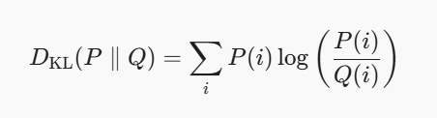
Common Non-Metric Similarity Functions
1. Cosine Similarity & Cosine Distance
Cosine similarity evaluates the cosine of the angle between two non-zero vectors regardless of their magnitude:
2. Kullback-Leibler (KL) Divergence
KL Divergence quantifies how one probability distribution $Q$ differs from a reference distribution $P$:
3. Dynamic Time Warping (DTW)
DTW measures similarity between two temporal sequences that may vary in speed or length by finding an optimal alignment path along a warp grid.

Slide 20
Proximity Between Binary Patterns
Proximity between binary vectors measures how closely two objects align when their features are
represented exclusively by binary values ($0$ or $1$, true or false, presence or absence).
1. The Binary Contingency Table
To compare two binary objects $\mathbf{x}$ and $\mathbf{y}$ of length $d$, we build a $2 \times 2$
contingency table mapping the counts of agreement and disagreement across all dimensions:
2. Symmetric vs. Asymmetric Binary Attributes
The choice of proximity measure depends on whether the binary attributes carry symmetric or asymmetric importance:
Symmetric Attributes: Both outcomes ($0$ and $1$) carry equal weight and equal information.
  Example: Gender (Male/Female), Pass/Fail status.
Asymmetric Attributes: Presence ($1$) carries significant meaning, while absence ($0$) is uninformative or vastly predominant.
  Example: Market basket analysis (buying item $A$ vs. not buying), disease symptoms, or keyword occurrence in text.

Slide 21
Different Classification Algorithms Based on the
Distance Measures

